Slide 1
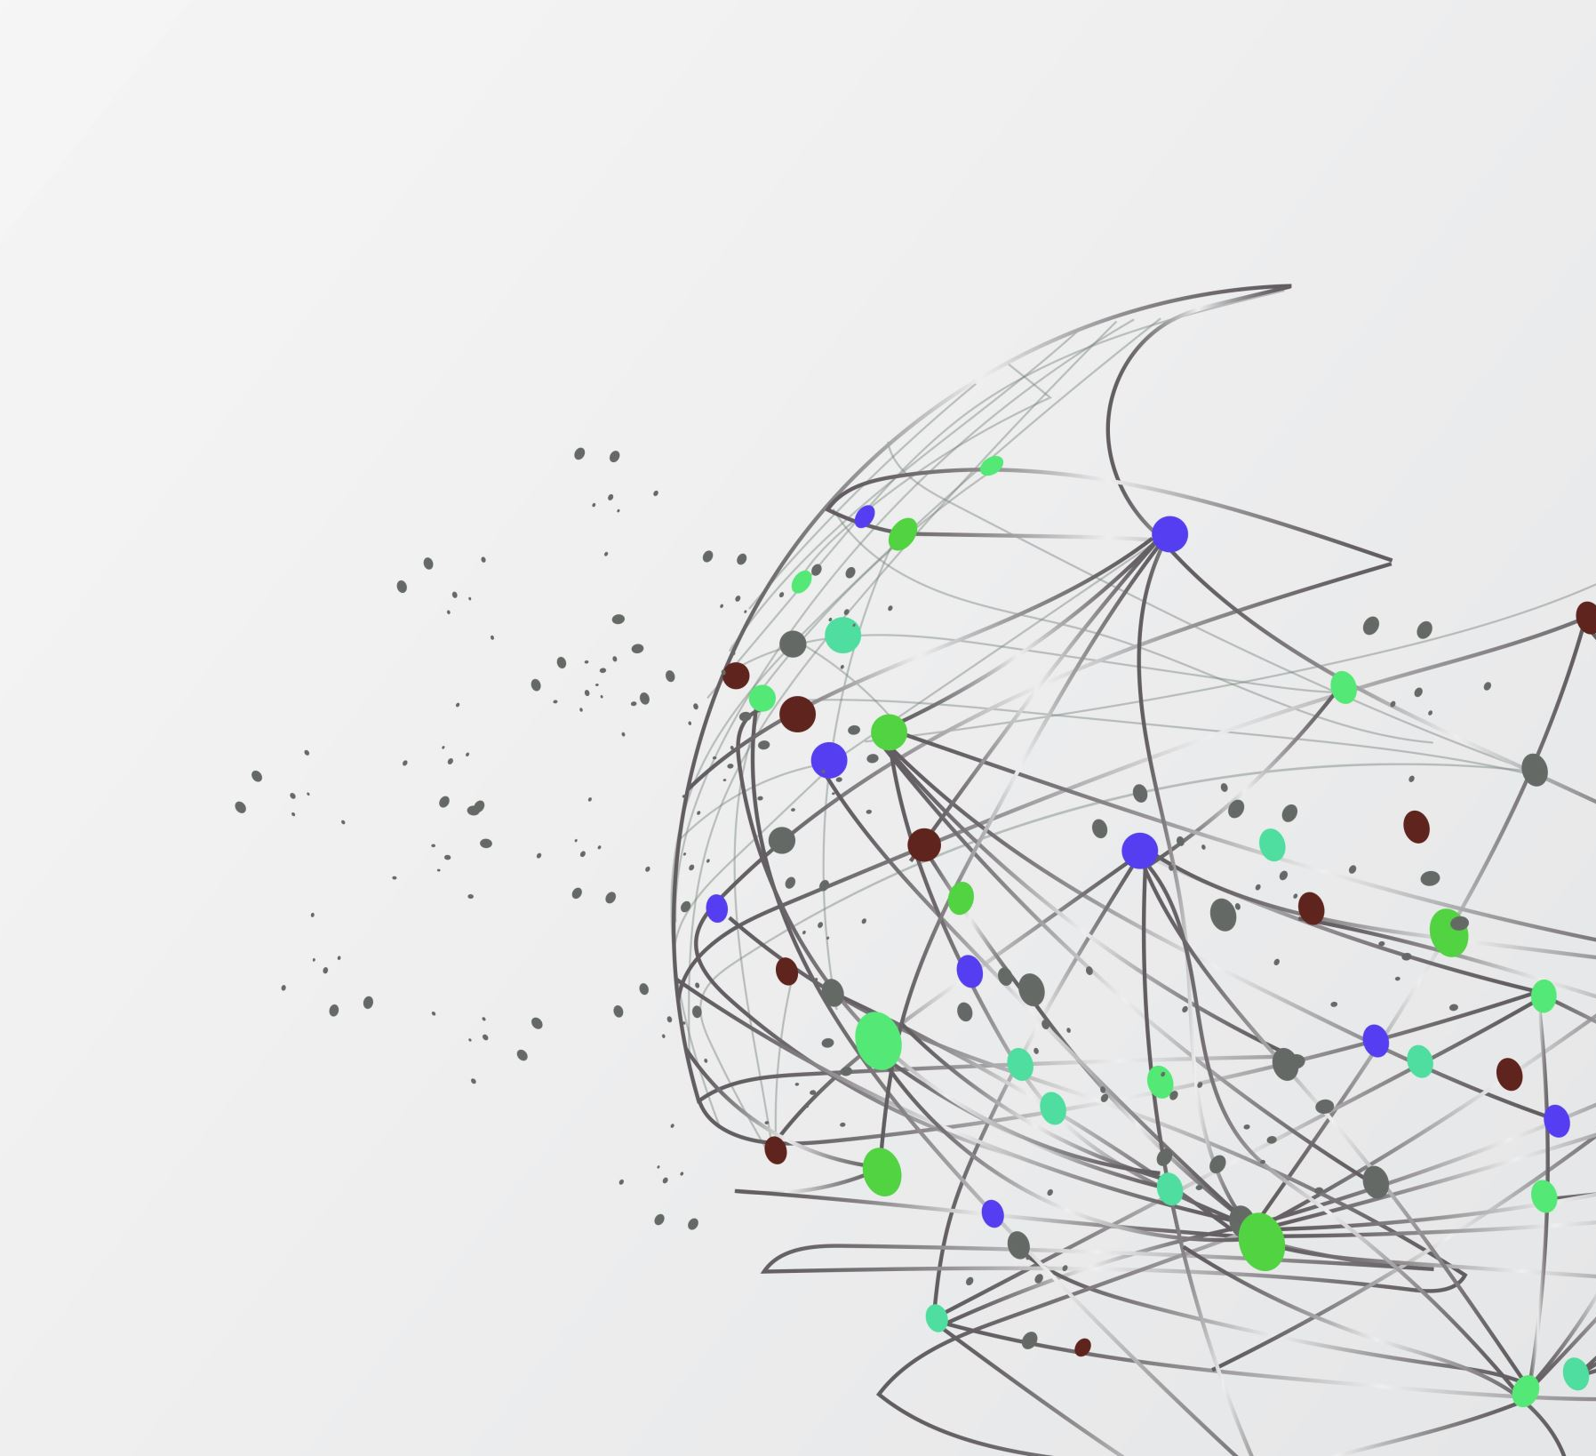
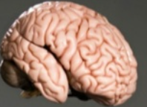
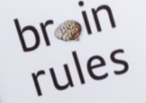
Brain rules

Slide 2

Introduction
“If you are in education, you are in the business of brain development …hence we need to know how brains work.”
Google.com

Slide 3
Rules of brain
Exercise
Survival
Wiring
Attention
Short-term memory
Long-term memory
Sleep
Stress
Sensory integration
Vision
Gender
Exploration

Slide 4
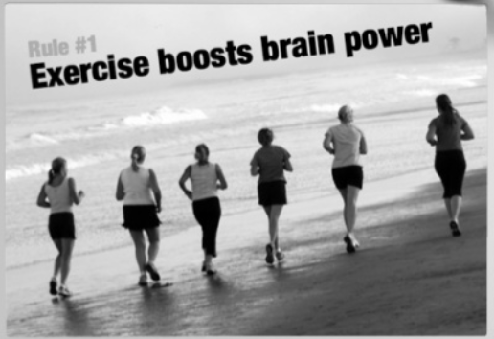
Rule 1^{st -} Exercise
Exercise boost the power of brain
Google.com

Slide 5
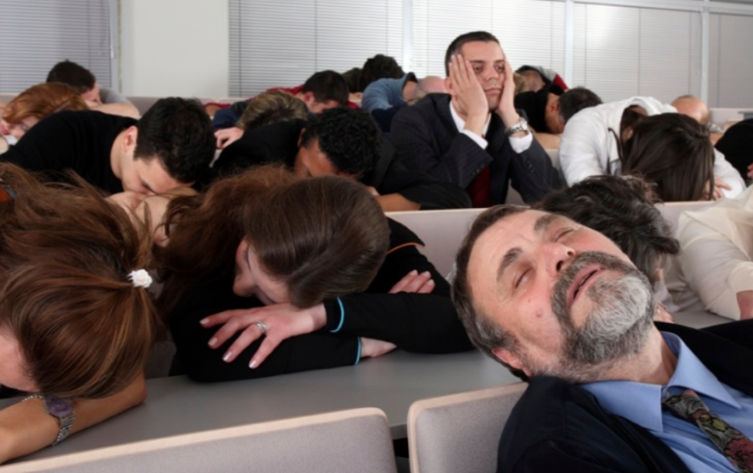
Rule 4th -Attention
We don’t pay attention to boring things
Avoid multitasking
Google.com

Slide 6

Multitasking
People who are interrupted –
Take 50% longer to complete task
Make 50% more error.
Google.com

Slide 7

Rule 10th - Vision
Vision trumps all other senses.
Google.com

Slide 8

Fact-
We have better recall by visual information
Google.com

Slide 9
References
Brain rule book –John medina
Summary of brain rule book by giggle app
Book – thinking slow and fast (Nobel prize winner) –Danial Kahneman.
https://youtu.be/TcMFFvNVQ8o
https://www.slideshare.net/garr/brain-rules-for-presenters/79-When_youre_always_online_youre

Slide 10
Thank you

